Slide 1
L E C T U R E
7
SOFTWARE PROJECT PLANNING
Notes:
This repository of slides is intended to support the named chapter. The slide repository should be used as follows:
Copy the file to a unique name for your course and unit.
Edit the file by deleting those slides you don’t want to cover, editing other slides as appropriate to your course, and adding slides as desired.
Print the slides to produce transparency masters or print directly to film or present the slides using a computer image projector.
Each slide includes instructor notes. To view those notes in PowerPoint, click-left on the View Menu; then click left on Notes View sub-menu. You may need to scroll down to see the instructor notes.
The instructor notes are also available in hardcopy as the Instructor Guide to Accompany Systems Analysis and Design Methods, 5/ed.

Slide 2
SOFTWARE PROJECT PLANNING
SOFTWARE PROCESS AND PROJECT METRICS
Software managers
planning involves estimation—your
attempt to determine how much money, how much effort, how many resources, and how much time it will take to build a specific software-based system or product.
If you want to build a house you have to know how much you need spend. Computer-based systems and products cost considerably more to build than a large house, it would seem reasonable to develop an estimate before you start creating the software.
What is it?
Who does it?
Why is it important?
What are the steps?
What is the work product?
How do I ensure that I’ve done it right?
Estimation begins with a description
of the scope of the product. Until the scope is “bounded” it’s not possible to develop a meaningful estimate
Table of different task
Function to be implemented
Cost, effort, time
A list of required project resources is also produced
That’s hard, because you won’t really know until the project has
been completed.

Slide 3
OBSERVATIONS ON ESTIMATING
Estimation of resources, cost, and schedule for a software engineering effort requires experience, access to good historical information, and the courage to commit to quantitative predictions when qualitative information is all that exists. Estimation carries inherent risk and this risk leads to uncertainty.
Project complexity
Project size
The degree of structural uncertainty

Slide 4
PROJECT PLANNING OBJECTIVES
The objective of software project planning is to provide a framework that enables the manager to make reasonable estimates of resources, cost, and schedule. These estimates are made within a limited time frame at the beginning of a software project and should be updated regularly as the project progresses. In addition, estimates should attempt to define best case and worst case scenarios so that project outcomes can be bounded.

Slide 5
SOFTWARE SCOPE
The first activity in software project planning is the determination of software scope. Function and performance allocated to software during system engineering
Software scope describes the data and control to be processed, function, performance, constraints, interfaces, and reliability.

Slide 6
Obtaining Information Necessary for Scope
How should we initiate communication between the developer and the customer?
The first set of context-free questions focuses on the customer, the overall goals and benefits and that will lead to a basic understanding of the problem. For example, the analyst might ask:
• Who is behind the request for this work?
• Who will use the solution?
• What will be the economic benefit of a successful solution?
• Is there another source for the solution?

Slide 7
The next set of questions enables the analyst to gain a better understanding of the problem and the customer to voice any perceptions about a solution:
• How would you (the customer) characterize "good" output that would be generated by a successful solution?
• What problem(s) will this solution address?
• Can you show me (or describe) the environment in which the solution will be used?
• Will any special performance issues or constraints affect the way the solution is approached?

Slide 8
The final set of questions focuses on the effectiveness of the meeting. Gause and Weinberg call these "meta-questions" and propose the following (abbreviated) list:
• Are you the right person to answer these questions? Are answers "official"?
• Are my questions relevant to the problem that you have?
• Am I asking too many questions?
• Can anyone else provide additional information?
• Should I be asking you anything else?

Slide 9
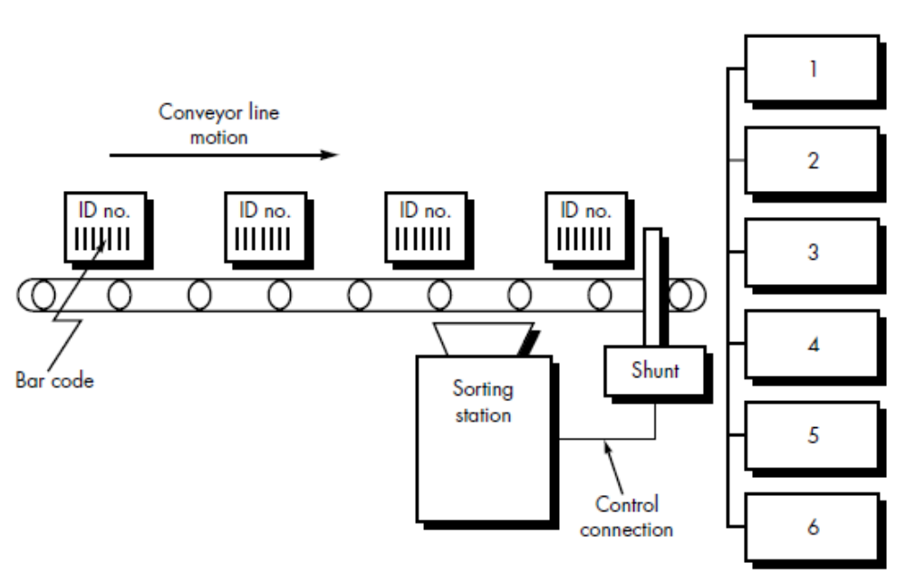
A Scoping Example
Conveyor Line Sorting System (CLSS)Software
The project planner examines the statement of scope and extracts all important software
functions. This process, called decomposition and
results in the following functions:
• Read bar code input.
• Read pulse tachometer.
• Decode part code data.
• Do database look-up.
• Determine bin location.
• Produce control signal for shunt.
• Maintain record of box destinations.
In this case, performance is dictated by conveyor line speed. Processing for each box must be completed before the next box arrives at the bar code reader. The CLSS software is constrained by the hardware

Slide 10
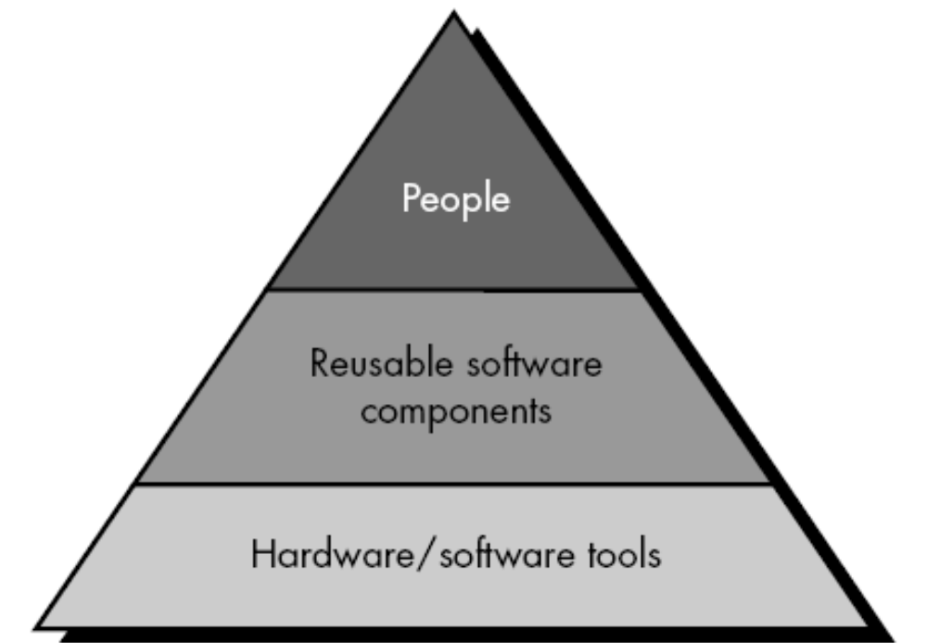
RESOURCES
What is the primary source of information for determining scope?

Slide 11
What issues should we consider when we plan to reuse existing software components?
The following guidelines should be considered by the software planner when
reusable components are specified as a resource:
If off-the-shelf components meet project requirements, acquire them. The cost for acquisition and integration of off-the-shelf components will almost always be less than the cost to develop equivalent software. In addition, risk is relatively low.
2. If full-experience components are available, the risks associated with modification and integration are generally acceptable. The project plan should reflect the use of these components.
3. If partial-experience components are available, their use for the current project must be analyzed.

Slide 12
SOFTWARE PROJECT ESTIMATION
Unfortunately, the first option, however attractive, is not practical.
Software cost and effort estimation will never be an exact science. Too many variables—human, technical, environmental, political—can affect the ultimate cost of software and effort applied to develop it.
To achieve reliable cost and effort estimates, a number of options arise:
1. Delay estimation until late in the project (obviously, we can achieve 100% accurate estimates after the project is complete!).
2. Base estimates on similar projects that have already been completed.
3. Use relatively simple decomposition techniques to generate project cost and effort estimates.
4. Use one or more empirical models for software cost and effort estimation.
Unfortunately, past experience has not
always been a good indicator of future results.
The remaining options are viable approaches to software project estimation.
The remaining options are viable approaches to software project estimation.

Slide 13
How do I compute the expected value for software size?
A three-point or expected value can then be computed. The expected value for the estimation variable (size), S, can be computed as a weighted average of the optimistic (sopt), most likely (sm), and pessimistic (spess) estimates. For example,
S = (sopt + 4sm + spess)/6

